Slide 1
Zenz Manual Getting started with your Zenz application
Nov 2021

Slide 2
Content – Zenz manual

Slide 3
Getting started

Slide 4
The Zenz application
The core of our solution provides insights into your data. The application is very fast, it is easy-to-use, and it provides aggregated views, while it also has easy access to all the details at the lowest level possible.
Zenz decision support systems are characterized by user friendliness and focus on business added value. Multiple data sources are integrated into a single system with all relevant levels of detail.
With our system you will have direct access to all data available with a single version of the truth. Analyses are replicable and figures are consistent.
This manual will help you to get started. However, feel free to just click and drag anywhere in the tool, because the fasted way to get to know our tool is by using it!

Slide 5
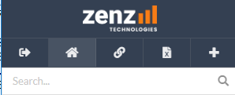
Analysis flow
The tool starts with a startup view. This view can be similar for everyone or customized per user group.
At any time, you have the possibility to:
Extend your analysis by adjusting your selection, adding objects, change dimensions, add or edit KPIs.
Open a saved view.
Go back to your startup view by clicking the ‘Home’ button.
This chapter will explain you how:
To adjust your current view
Save and open views
Create exports
Some Zenz terminology and convenient shortcuts

Slide 6
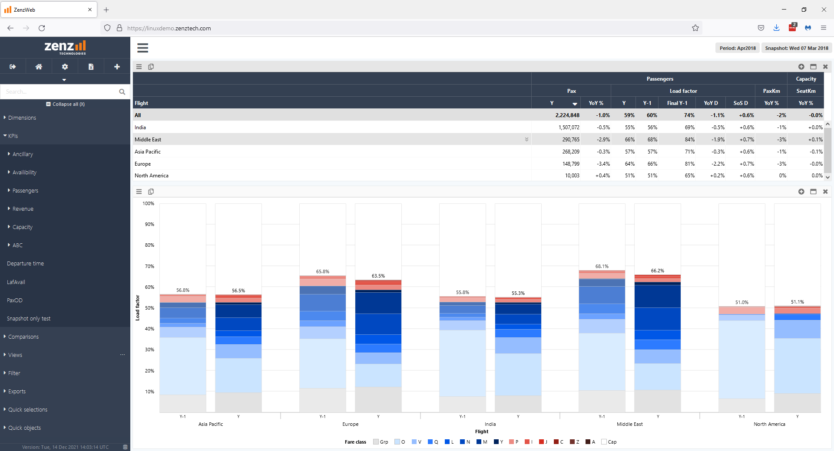
Opening the tool
You can access your web application in a standard web browser (Chrome, Firefox, ..)
https://app-livinparis.zenztech.com
Once the tool is started, you have the option to:
Start a new analysis
The tool will start from a startup view chosen by your administrator.
Open a saved view
Open a .zenz document from a folder
Once you made this choice, it is time to analyze!
An example startup view

Slide 7
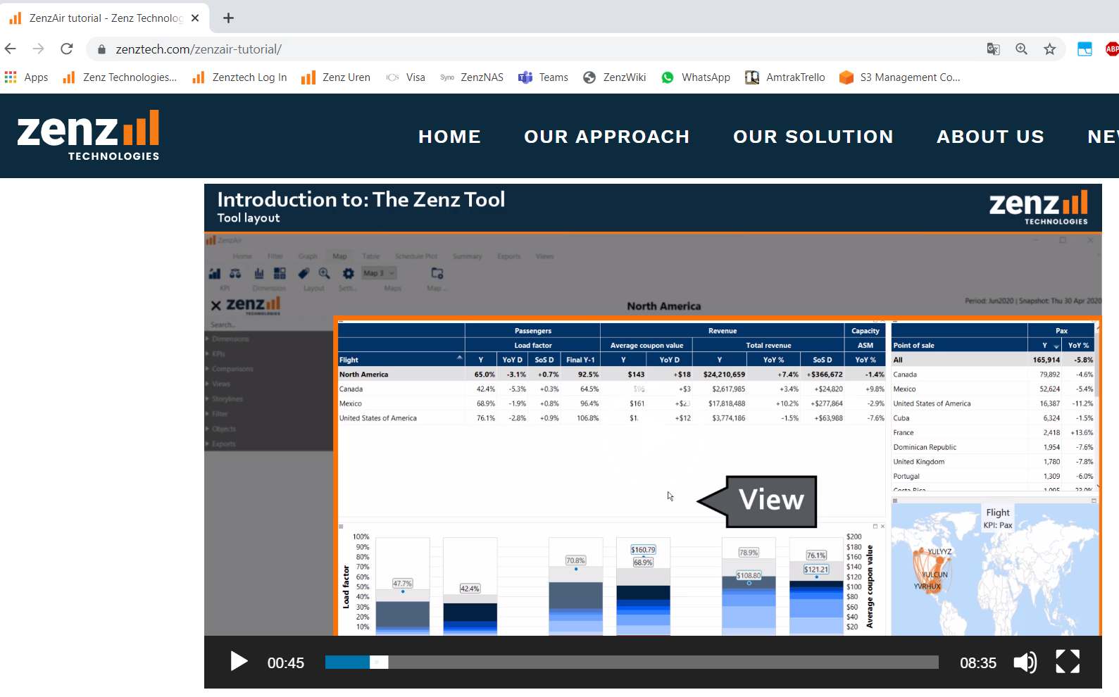
Zenz video introduction
If you prefer to watch a video introduction to the Zenz tooling user interaction, this would be a good timing to watch the video’s on our website.
Currently we created 3 video’s
Introduction to the Zenz tool
Introduction to Graphs
Introduction to Tables
The video’s were created using the desktop application. But the user interaction is very similar to web, so still useful for web users!
https://www.zenztech.com/zenzair-tutorial/

Slide 8
Title bar
The title bar consists of a title, subtitle and all selected filters.
The title and subtitle can be freely set, and will be saved in the view (double-click the title).
Filters are by default shown in the top right corner. To highlight a filter you can drag it to the title or subtitle position.

Slide 9
KPIs and Dimensions
KPI
Any variable that is loaded in the tool, which can be displayed in graphs or tables
KPIs are variables that can be counted or calculated
Dimension
A dimension is a grouping which is defined to either split or filter KPI values.
A split is made when a dimension is used on the X-axis or legend of a graph or in the rows/columns of a table

Slide 10
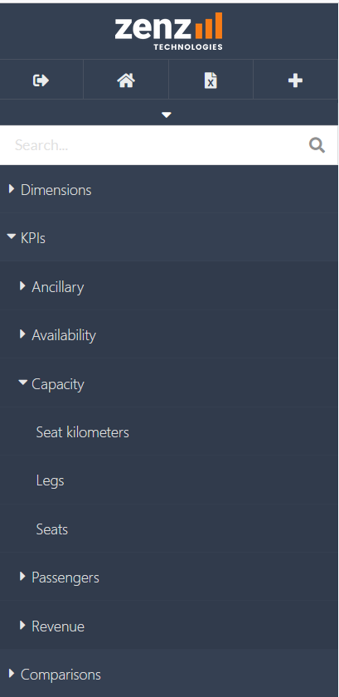
Add/edit KPIs and dimensions in graphs and tables Extend your analysis by adjusting your selection, change dimensions or add or edit KPIs
There are multiple ways to add or edit KPIs and dimensions in graphs and tables:
By dragging and dropping dimensions or KPIs on the relevant places in graphs or tables.
Drag and drop from the sidebar (show in the image to the right)
Drag and drop between or within objects
By right-clicking dimensions, KPIs or other elements in your graph.
By using the object dropdown menu
Tip: it is easier if you start from an existing table/graph, and change the relevant components instead of trying to start from an empty table or graph

Slide 11
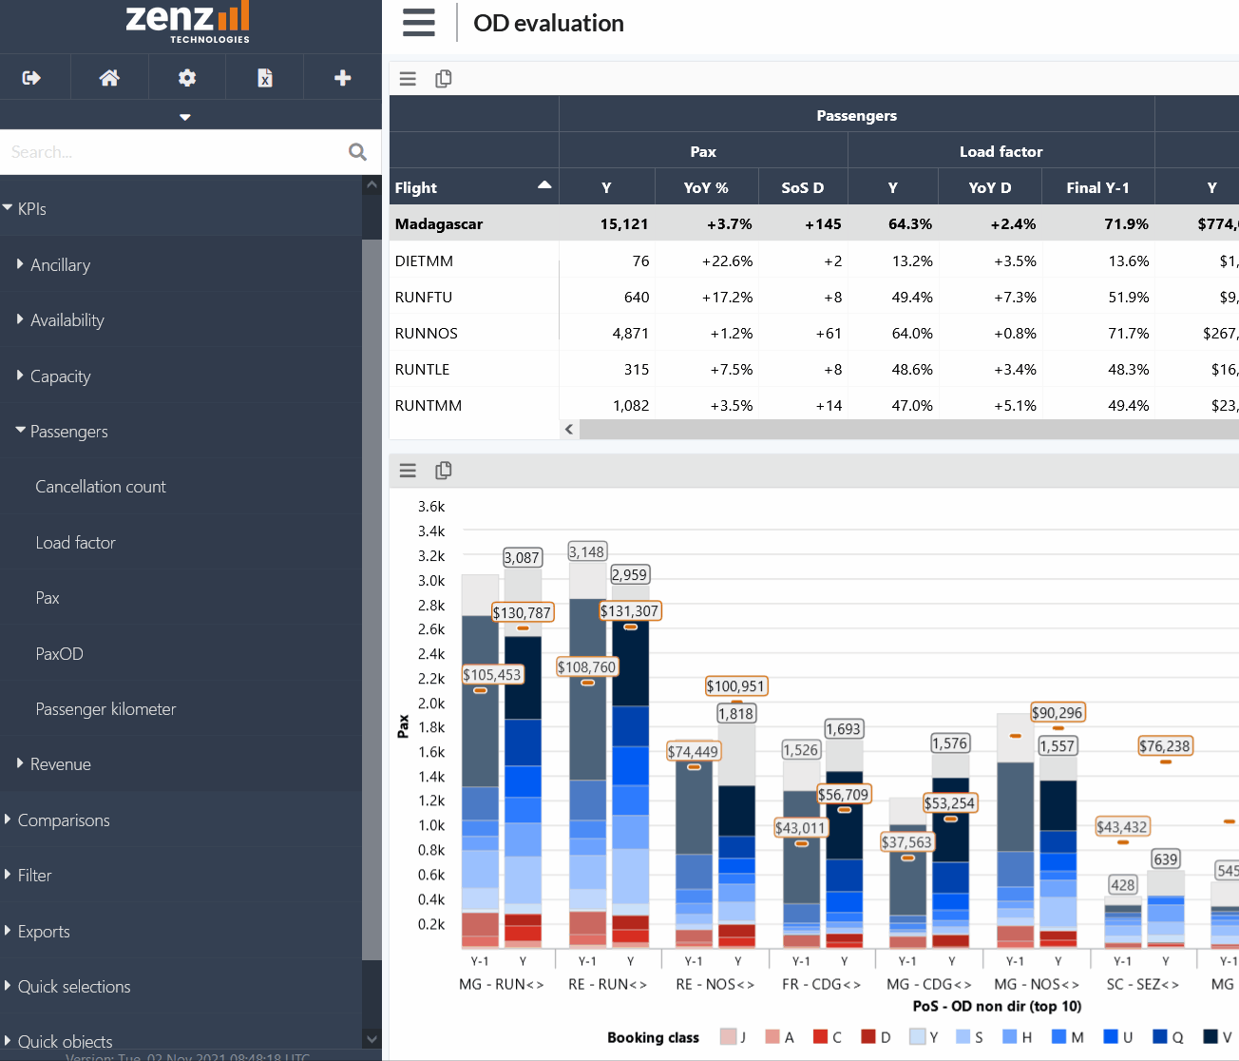
Drag and drop
You can drag and drop KPIs and dimension from the sidebar on the left, but also from one graph to another. Examples:
Dragging a dimension such as from within a graph on another dimension in the same graph swaps the dimensions.
Dragging between objects replaces or adds the dimension.
Example: drag ‘Load factor’ from the sidebar on top of ‘Pax’ in the graph to replace this KPI.

Slide 12
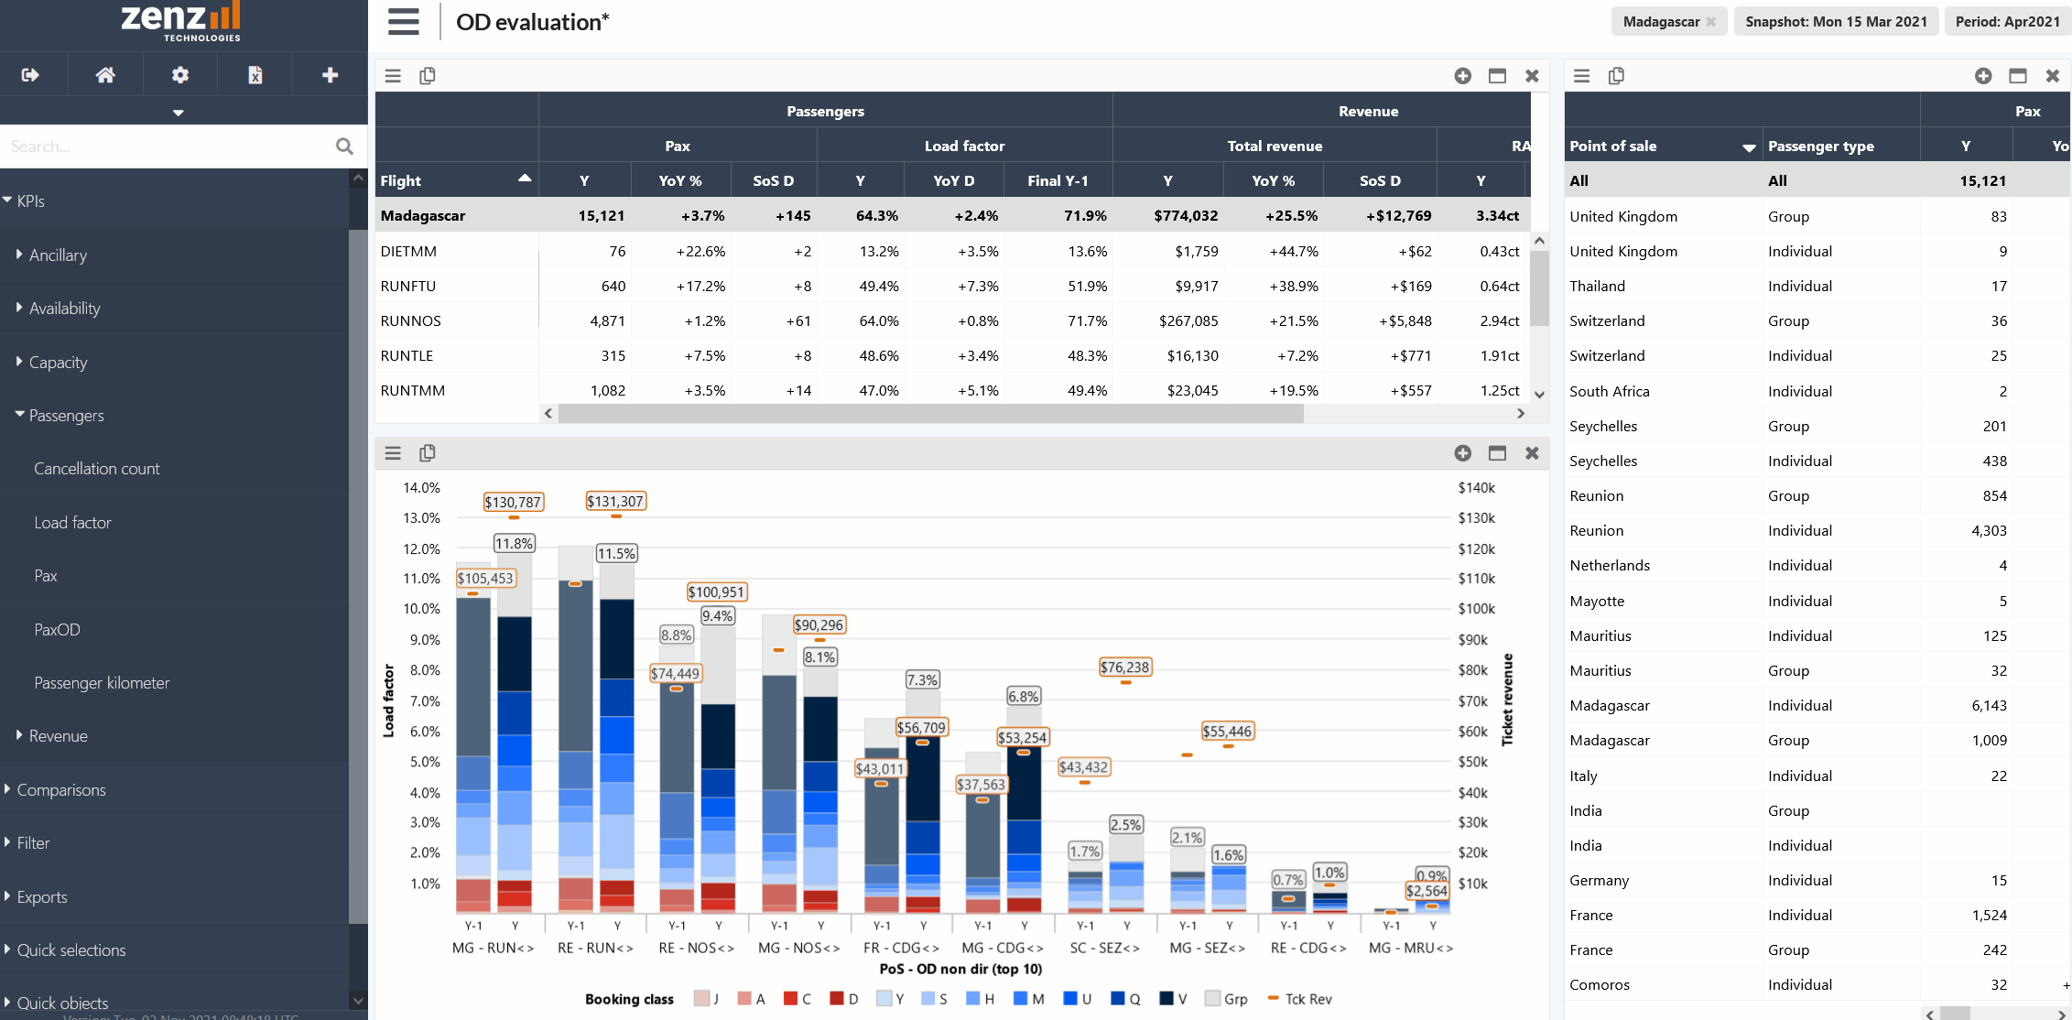
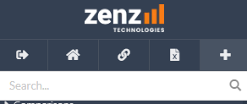
Adding new objects
In the web interface you can add new graphs, tables or other object via the ‘+’ button at the top of the sidebar
Drag and drop the object via it’s title bar to rearrange the layout of your view

Slide 13
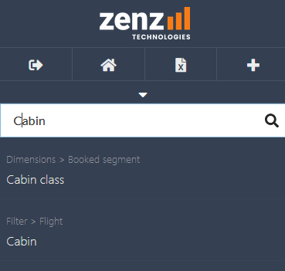
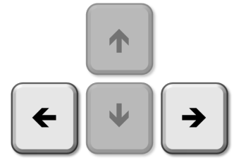
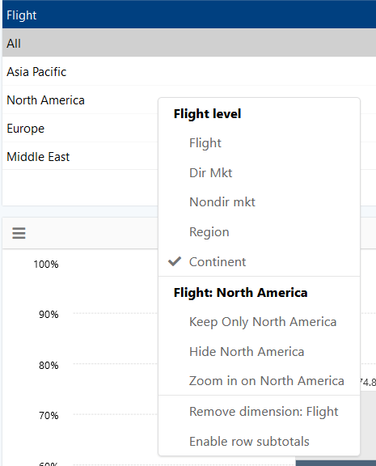
Quickly changing a selection
Open hierarchy filter dialogs from the filter tab in the sidebar or use the search functionality
For example: search ‘suffix’ and select the filter option
Keyboard shortcuts to change the selected period or snapshot
Press the left/right arrow keys to shift the selected period
Hold shift + press left/right arrow keys to extend the period forward in time or backward in time
Hold ctrl + press left/right arrow key to change the selected snapshot
Using your mouse
Right-click on an element in a table or graph to
Keep only this element
Hide this element
Zoom in on this element (for multi-level hierarchies)
Click on an active filter text in the title bar (top-right of your screen) to open the filter menu of this dimension

Slide 14
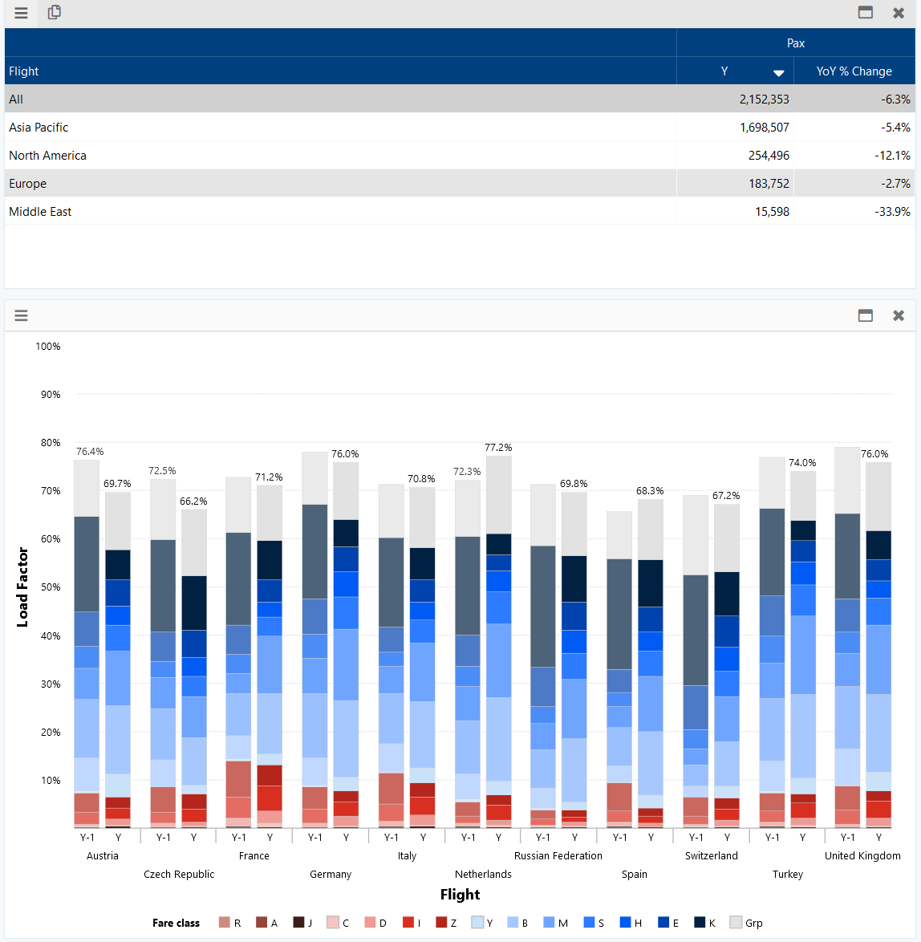
Soft select
Select a row in a table and other tables and graphs in the current view will show only the selected row.
For example: ‘Europe’ flights are selected in the picture on the right
This selection is temporary. As soon as you click on another row the selection will be reset
The current soft selected element will be shown between [ ] in the filter text
Use the UP and DOWN keys on your keyboard to quickly browse through the rows in the table

Slide 15
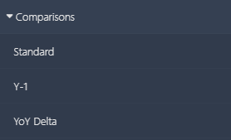
Comparisons
Any KPI included in Zenz can be analyzed using comparisons.
A ‘comparison’ is a definition or calculation change of a metric.
You can add or replace comparisons using drag and drop from the sidebar.
For “comparable snapshot last year” definition, see next slide.
Comparison label | Definition / calculation
Standard | Current value with current snapshot
Y-1 | Value of similar period last year on comparable snapshot last year
YoY Delta | Difference between standard and Y-1 value
YoY% | YoY Delta as percentage of Standard value
YoY index | Standard / Y-1
Final
Final Y-1 | Value of similar period last year on today’s snapshot
SoS Delta | Difference of value between snapshot today and yesterday
WoW | Difference of value between snapshot today and 7 days ago
Y-2 | All Y-1 calculations mentioned above are also available for Y-2

Slide 16
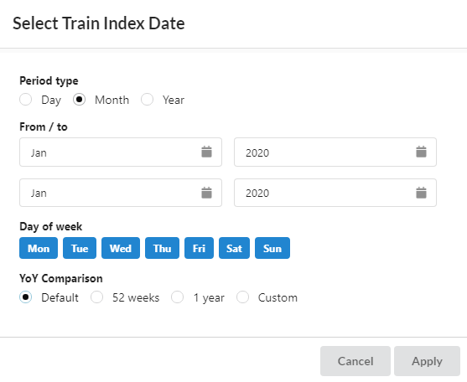
Period settings / Date Comparisons
When YoY Comparison is set to ‘Default’, Zenz applies the following logic:
Departure day is compared to departure day with same DoW previous year (i.e. 52 week ago)
Departure week is compared to same departure week previous year
Departure month is compared to same departure month previous year
In the date filter menu users can set the YoY Comparison to different options:
1 Year: always compare with exactly same date previous year.
52 weeks: always compare with exactly same week previous year.
Custom: choose the period you would like to compare t0 the current period. All comparisons are adjusted accordingly.

Slide 17
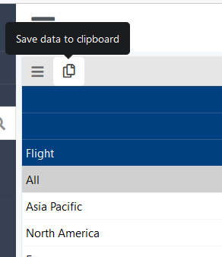
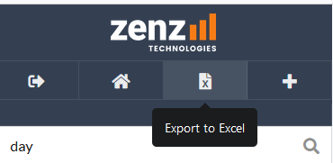
Export your data
You can copy the table numbers to your clipboard via the ‘copy’ button in the title bar of any table.
You can export your data to csv / excel via the ‘export’ button at the top of the sidebar.
A dialog with export settings will open
This dialog is pre-filled with the settings from your current active object
You can adjust your export settings to your desire

Slide 18
Zenz terminology (1/2)
What? | Definition
KPI | Any variable that is loaded in the tool, which can be displayed in graphs or tables
Comparisons | KPIs can be analyzed using their ‘standard’ comparison. However, sometimes you’d like to use a derived unit of a KPI. For example, the difference between the value of a KPI today vs its value last year.
Dimension | A dimension is a grouping which is defined to either split or filter KPI values. A split is made when a dimension is used on the axis of a graph or in the rows/columns of a table
Hierarchy | A hierarchy closely linked to a dimension. A hierarchy describes the relation between the elements in a dimension. For example: a flight a route AMS-LDN is part of the higher flight level ‘England’, which is part of ‘Europe’
Views | A screen with all its settings and configurations is saved in a ‘view’.
Objects | Graphs, tables, maps etc are all objects. All objects together form your screen, or view.

Slide 19
Zenz terminology (2/2)
What? | Definition
Snapshot | A snapshot is a specific moment in time. For example, if we look at snapshot 27 may 2019, we look at all values updated until this date. Even though we might be looking at forward looking data of all flights with departure date June. These values will be different in the next snapshot.
YoY | Year over year. This is usually a comparison, which makes it very easy to compare the results of the selected period to the same period last year. The YoY comparison can be defined day of week aligned
SoS | The Snapshot over Snapshot comparison compares snapshots. By default it compares current snapshot with the one of yesterday. However, this can be customized to weekly, monthly or custom comparison.

Slide 20
Shortcuts
What? | Shortcut
Sale data deduct / add period | Shift + arrow left / right
Shift period back/forward | Arrow left / right
Undo | Ctrl + Z
Redo | Ctrl + Y
Select number of years (current period selectin) | 1, 2, 3, etc…
Move snapshots back / forth (e.g., stock date) | Ctrl + arrow left / right

Slide 21
Saving and sharing your work

Slide 22
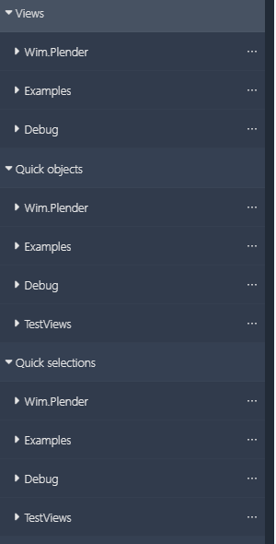
User groups
Every user always has his/her own ‘user group’ where you can save your work.
On top of that you can be assigned as a member of one or more user groups.
For example, you can be assigned to a group based on your location as well as the department or project you are part of.
User groups are used to share views, exports, objects, selections, etc.
If desired, administrators can also assign KPI or hierarchy restrictions to a whole group. In this case, a KPI or hierarchy is restricted as a whole.
For example, if you do not want some users to see data on a very detailed level.

Slide 23
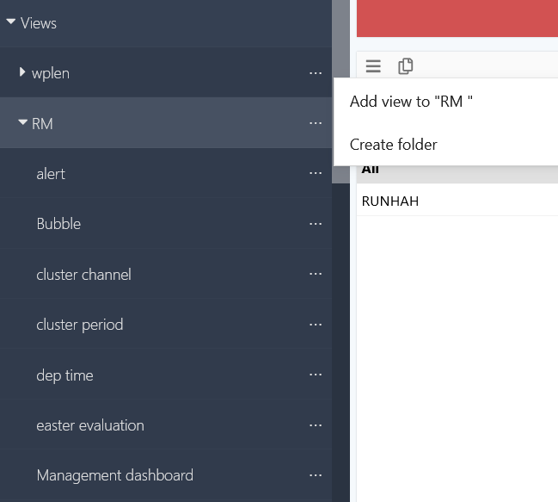
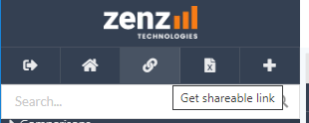
Saving views
You can save your current view at any time.
To save your current view go to the ‘views’ tab in the sidebar and click on the ‘…’ icon of the subfolder/group where you want to save your view and click “Add new view”.
To replace an existing view, click on the ‘…’ icon of an existing view.
Views saved within a user group can be opened and edited by anyone who is a member of this user group.
Share a link with a colleague
To quickly share a view with a colleague and not structurally save the view in a specific way you can click the ‘Get shareable link’ button at the top of the sidebar.
You can send the link to anyone, and they will open your view if they have the necessary authorization.

Slide 24
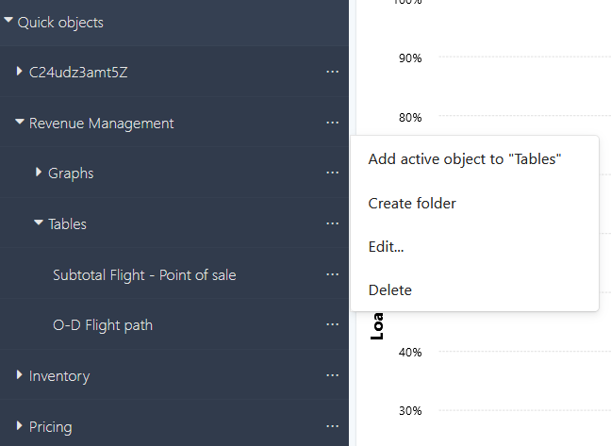
Saving quick objects
Quick objects are a convenient way to add specific or frequently used object to other views.
You can save and share any individual table, graph or other object.
Save or open an active object via the ‘quick objects’ tab in the sidebar.
Tip:
An object is “active” when the small toolbar above the object is highlighted
(the map is activated in this example)
You can “activate” an object by clicking on it.

Slide 25
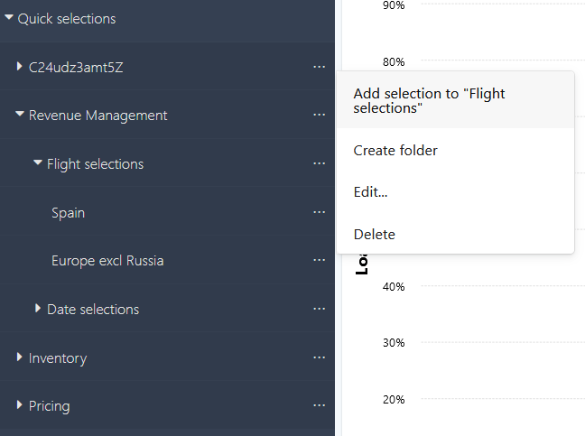
Saving quick selections
Quick Selection are convenient when you want to use your data selection for multiple views.
You can save and share any set of filters via Quick Selections.
Save a your current set of filters as a quick selection via the ‘quick selections’ tab in the sidebar.
Open a previously saved quick selection by clicking the quick selection in the sidebar.

Slide 26
Saving exports
Exports that have been saved in the desktop application can easily be repeated by opening them from the sidebar.
Currently it is not yet possible to save exports in the web-app
This will be added soon

Slide 27
Customizing graphs and tables

Slide 28
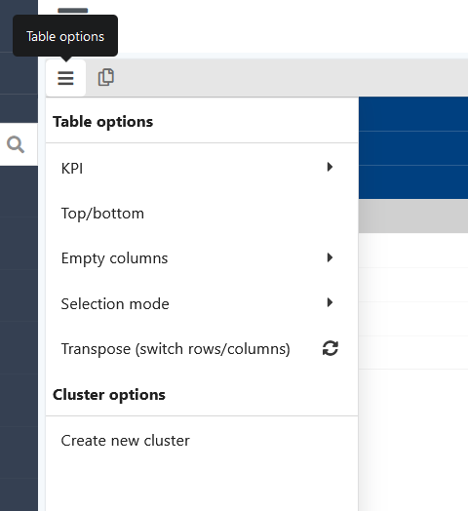
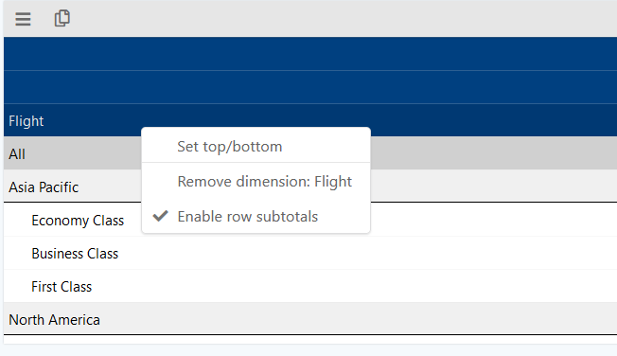
Table settings – Customizing your table
Most table settings are set per KPI, in the ‘Edit KPI dialog’, which is found in the dropdown menu of a table.
Nr of decimals can be adjusted when you do not like the default properties.
Conditional formatting thresholds can be defined as well as the color schemes.
Use the Top/bottom functionality to only show interesting cases to analyze.
Right-click a dimension header to enable row subtotals (pivot-table style).
The settings above will only impact your table within that view. Not all other reporting.

Slide 29
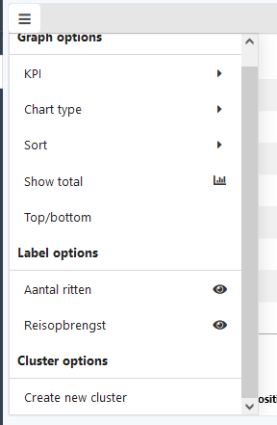
Graph settings – Customizing your graph
Chart types
Bar, Line, Bubble or Waterfall
Horizontal or vertical
Sorting options
Top/bottom
For example, show only top 10 biggest propositions
Can also be based on biggest difference (YoY)
Graph elements can be hidden
Axis title, X-axis, Legend
Convenient when you want to create more space
Label options
To enable/disable labels click the eye icon per KPI
For more specific label settings, click on the KPI to open the KPI label menu

Slide 30
Formatting introduction
The Zenz software is build as an analysis tool first, therefore we build the tool in such a way that tables and graphs are automatically labelled and formatted in an intuitive way.
For example, when you replace a KPI in a graph, the Y-axis label is automatically adjusted.
However, sometimes you might want to overwrite the standard labels or standard coloring.
Warning: We advice you to only use custom object titles when you really want to, because you lose the automatic labelling features.
For this reason, we advice to not use custom titles in your startup screen!

